Slide 1
COMPUTER GRAPHICS & MULTIMEDIA
UNIT-2
-by Sakshi Jha

Slide 2
SYLLABUS
Clipping Algorithms: Sutherland-Cohen line Clipping Algorithm,
Bezier Curves,
B-Spline Curves.
Parallel projection,
Perspective Projection,
Illumination Model for diffused Reflection,
Ambient light,
Specular Reflection Model,
Reflection Vector.

Slide 3
ILLUMINATION MODEL FOR DIFFUSED REFLECTION

Slide 4
An illumination model, also called a lighting model and sometimes referred to as a shading model, is used to calculate the intensity of light that we should see at a given point on the surface of an object.
Illumination models in computer graphics are often loosely derived from the physical laws that describe surface light intensities.
There are three factors on which lightning effect depends on:
1.Light Source :
Light source is the light emitting source. There are three types of light sources:
Point Sources – The source that emit rays in all directions (A bulb in a room).
Parallel Sources – Can be considered as a point source which is far from the surface (The sun).
Distributed Sources – Rays originate from a finite area (A tubelight).
Their position, electromagnetic spectrum and shape determine the lightning effect.
2.Surface :
When light falls on a surface part of it is reflected and part of it is absorbed. Now the surface structure decides the amount of reflection and absorption of light. The position of the surface and positions of all the nearby surfaces also determine the lightning effect.
3.Observer :
The observer’s position and sensor spectrum sensitivities also affect the lightning effect.

Slide 5
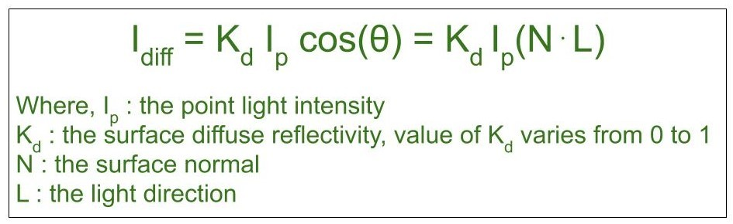

DIFFUSE REFLECTION
Diffuse reflection occurs on the surfaces which are rough or grainy. In this reflection the brightness of a point depends upon the angle made by the light source and the surface.
The reflected intensity $I_{diff}$of a point on the surface is:

Slide 6
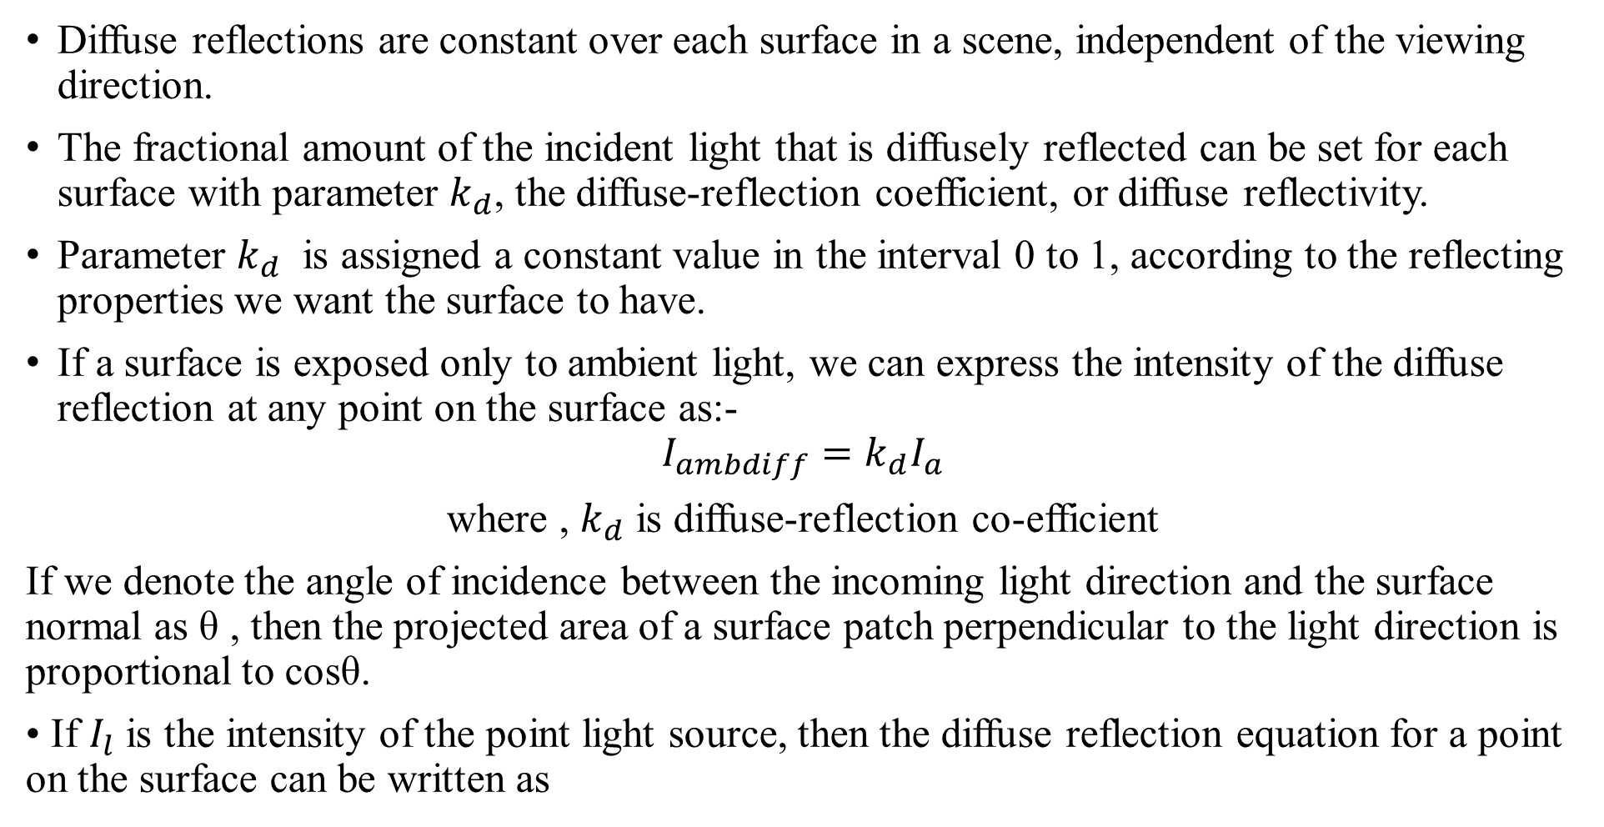
Diffuse reflections are constant over each surface in a scene, independent of the viewing direction.
The fractional amount of the incident light that is diffusely reflected can be set for each surface with parameter $k_{d}$, the diffuse-reflection coefficient, or diffuse reflectivity.
Parameter $k_{d}$ is assigned a constant value in the interval 0 to 1, according to the reflecting properties we want the surface to have.
If a surface is exposed only to ambient light, we can express the intensity of the diffuse reflection at any point on the surface as:-
$$I_{ambdiff}=k_{d}I_{a}$$
where , $k_{d}$ is diffuse-reflection co-efficient
If we denote the angle of incidence between the incoming light direction and the surface normal as θ , then the projected area of a surface patch perpendicular to the light direction is proportional to cosθ.
• If $I_{l}$ is the intensity of the point light source, then the diffuse reflection equation for a point on the surface can be written as

Slide 7
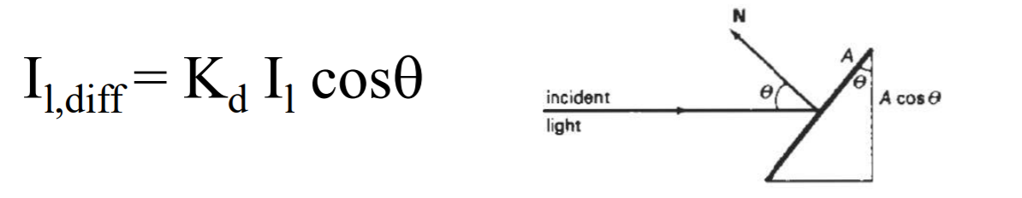

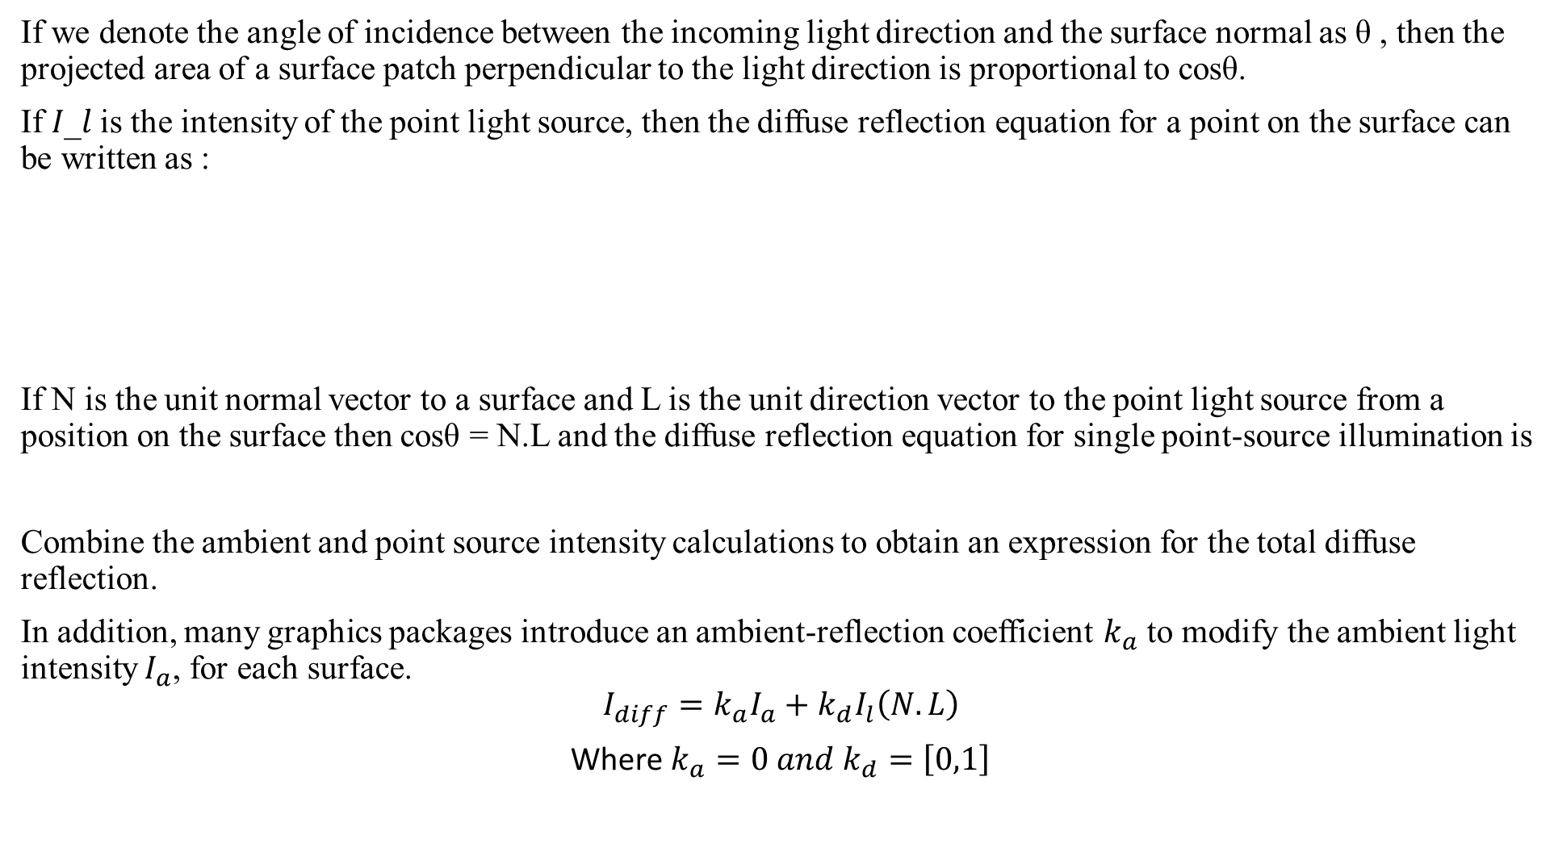
If we denote the angle of incidence between the incoming light direction and the surface normal as θ , then the projected area of a surface patch perpendicular to the light direction is proportional to cosθ.
If 𝐼_𝑙 is the intensity of the point light source, then the diffuse reflection equation for a point on the surface can be written as :
If N is the unit normal vector to a surface and L is the unit direction vector to the point light source from a position on the surface then cosθ = N.L and the diffuse reflection equation for single point-source illumination is
Combine the ambient and point source intensity calculations to obtain an expression for the total diffuse reflection.
In addition, many graphics packages introduce an ambient-reflection coefficient $k_{a}$ to modify the ambient light intensity $I_{a}$, for each surface.
$$I_{diff}=k_{a}I_{a}+k_{d}I_{l}\left(N.L\right)$$
Where $k_{a}=0 and k_{d}=\left[0,1\right]$

Slide 8
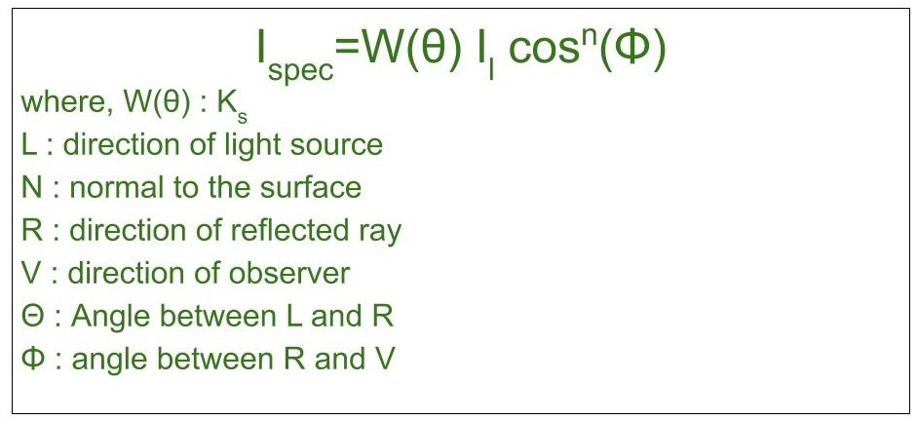

SPECULAR REFLECTION
When light falls on any shiny or glossy surface most of it is reflected back, such reflection is known as Specular Reflection.
Phong Model is an empirical model for Specular Reflection which provides us with the formula for calculation the reflected intensity $I_{spec}$:

Slide 9
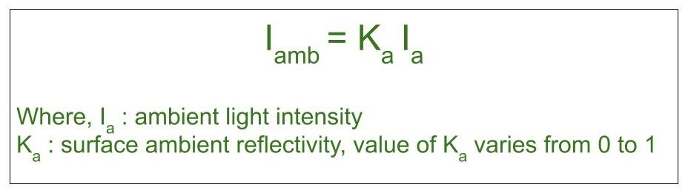
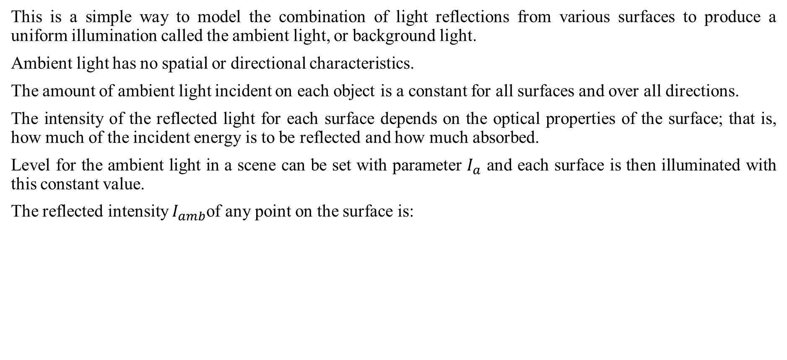
AMBIENT LIGHT
This is a simple way to model the combination of light reflections from various surfaces to produce a uniform illumination called the ambient light, or background light.
Ambient light has no spatial or directional characteristics.
The amount of ambient light incident on each object is a constant for all surfaces and over all directions.
The intensity of the reflected light for each surface depends on the optical properties of the surface; that is, how much of the incident energy is to be reflected and how much absorbed.
Level for the ambient light in a scene can be set with parameter $I_{a}$ and each surface is then illuminated with this constant value.
The reflected intensity $I_{amb}$of any point on the surface is:

Slide 10
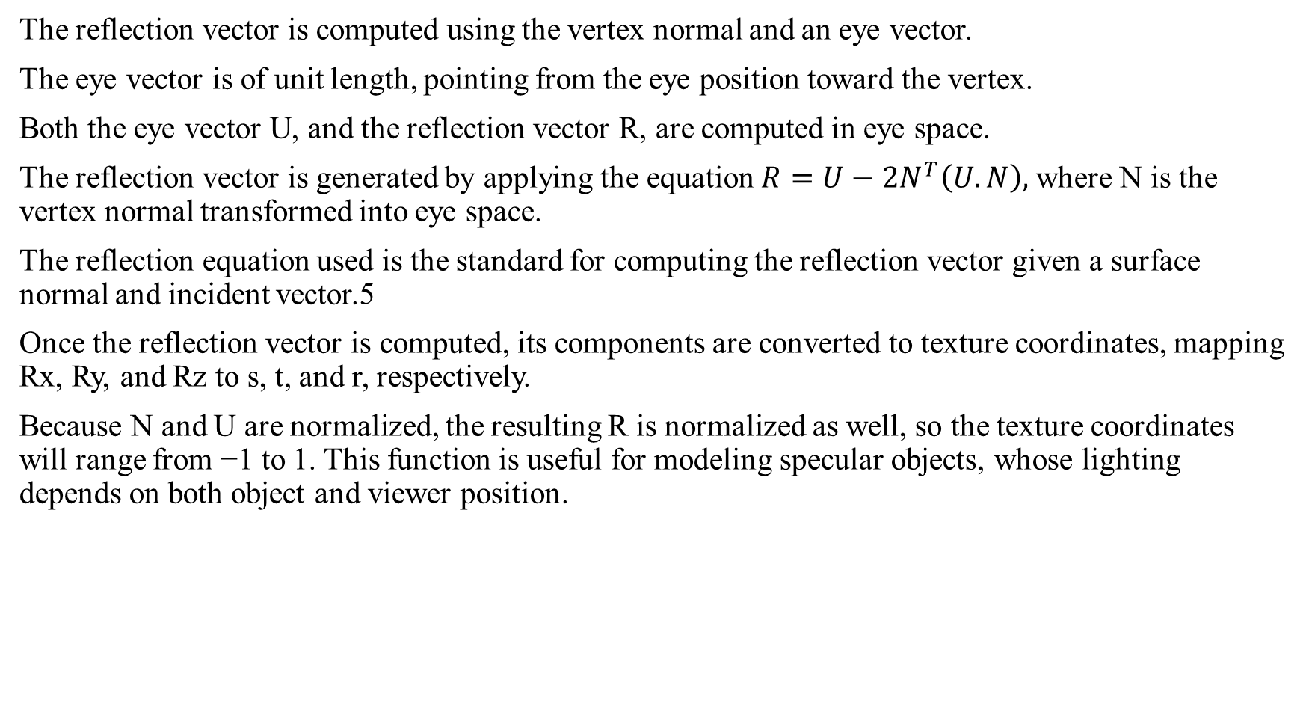
REFLECTION VECTOR
The reflection vector is computed using the vertex normal and an eye vector.
The eye vector is of unit length, pointing from the eye position toward the vertex.
Both the eye vector U, and the reflection vector R, are computed in eye space.
The reflection vector is generated by applying the equation $R=U−2N^{T}\left(U.N\right),$where N is the vertex normal transformed into eye space.
The reflection equation used is the standard for computing the reflection vector given a surface normal and incident vector.5
Once the reflection vector is computed, its components are converted to texture coordinates, mapping Rx, Ry, and Rz to s, t, and r, respectively.
Because N and U are normalized, the resulting R is normalized as well, so the texture coordinates will range from −1 to 1. This function is useful for modeling specular objects, whose lighting depends on both object and viewer position.

